Slide 1
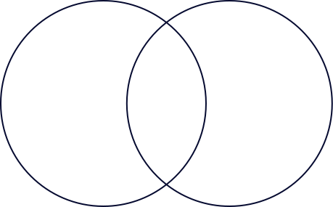
Solving an Image Captioning Task Using Deep Learning
PROJECT PRESENTATION
Team Members: Nayan Pandey, Saifee Mohammad Khizar, Krish Tare, Arshad Shaikh, Abhishek Gupta

Slide 2




Introduction
Goal: Build a deep learning model that generates descriptive captions for images.
Fields involved: Computer Vision + NLP
Dataset: Flickr8k
Tools: CNN (InceptionV3), LSTM, Attention Mechanism

Slide 3

Objectives
• Preprocess the Flickr8k dataset.
• Extract image features using pre-trained CNN.
• Prepare captions (cleaning, tokenizing).
• Build encoder-decoder model (CNN + LSTM).
• Integrate attention mechanism.
• Evaluate using BLEU score & manual review.

Slide 4
Dataset Overview
Dataset: Flickr8k
• 8,000 images
• 5 captions per image
Files Used:
• Flickr8k.token.txt
• Flickr8k_Dataset/

Slide 5
Methodology - Image & Caption Preprocessing
  Image Preprocessing:
  • Used InceptionV3 (ImageNet weights)
  • Resized to 299x299 pixels
  • Feature extraction from penultimate layer
  Caption Preprocessing:
  • Cleaned, lowercased, tokenized
  • Added <start> and <end> tokens
  • Padded sequences

Slide 6

Model Architecture
1
Encoder: InceptionV3
2
Decoder: LSTM with Embedding + Attention Layer
3
Loss: SparseCategoricalCrossentropy
4
Optimizer: Adam
5
Include a diagram of the Encoder-Decoder architecture

Slide 7


Training
• Trained over 10 epochs
• Early stopping applied
• Evaluated using BLEU Score
• Limited by hardware and dataset size

Slide 8
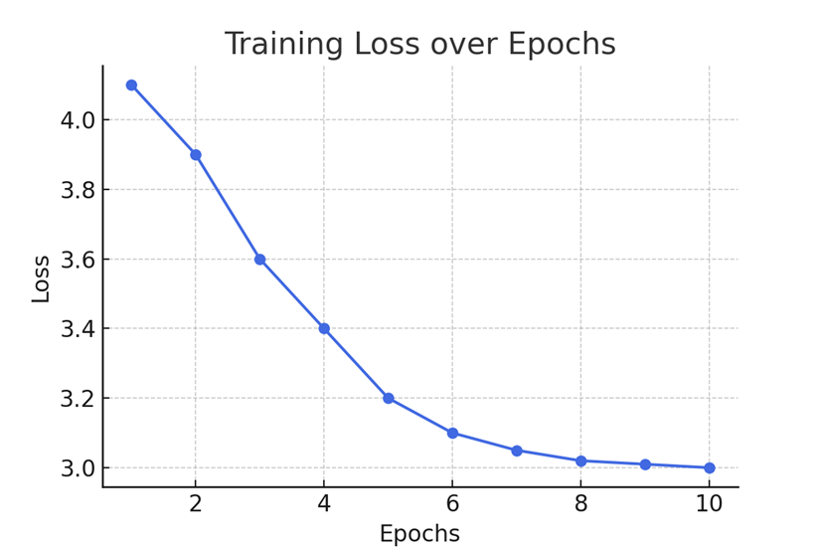
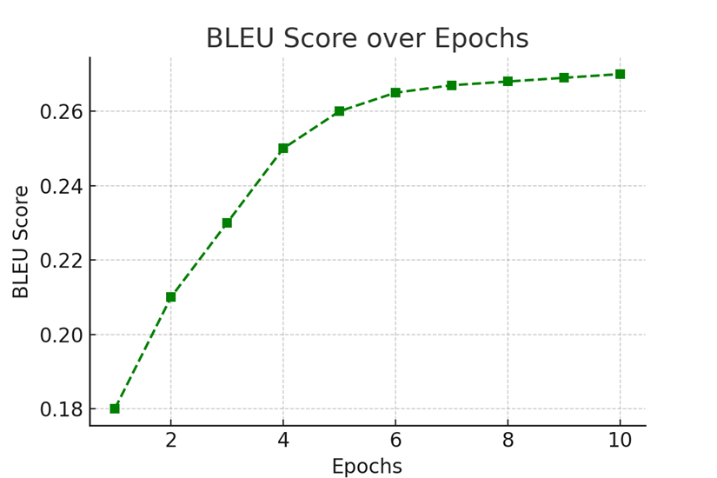
Training Results
Graph 1: Training Loss Curve (Insert the provided graph)
Graph 2: BLEU Score Trend (Insert the provided graph)

Slide 9
Observations & Challenges
  Observations:
  • Captions generated were basic, sometimes semantically correct
  • Attention improved coherence
  Challenges:
  • Limited system memory
  • Low BLEU score due to dataset constraints
  • Caption diversity affected performance

Slide 10
Learning Outcomes
• Full understanding of image captioning pipeline
• Hands-on with CNN-RNN + attention
• Improved problem-solving in model debugging & tuning

Slide 11

Conclusion & Future Scope
  Conclusion:
  • Achieved end-to-end pipeline with basic output
  • Highlighted importance of data and tuning
  Future Scope:
  • Use Transformer models
  • Larger datasets (e.g., MS COCO)
  • Web/app deployment
  • Beam search for better captioning

Slide 12
• Nayan Pandey
• Saifee Mohammad Khizar
Team Contributions
• Krish Tare
• Arshad Khan
• Abhishek Gupta

